Slide 1

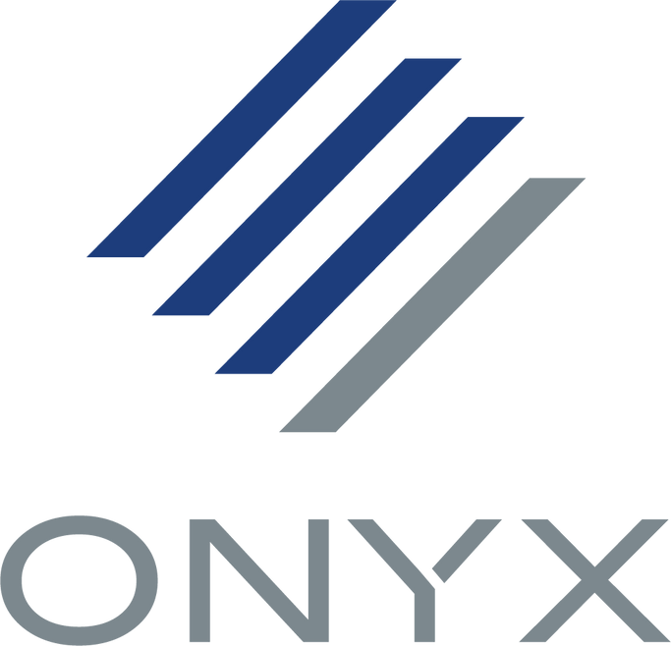

Sustaining Innovation
ONYX Go Subscription Pricing Update
Address
Website
6915 South High Tech Drive, Midvale, Utah, 84047
www.onyxgfx.com

Slide 2
Supporting Value & Growth
ONYX Go Price Adjustment 2025
Why the Change?
This marks the first pricing adjustment since ONYX Go was launched in 2022. Over the past three years, we’ve continued to invest in development, support, and new capabilities without raising the cost to users. The upcoming change reflects the significant value we’ve added while ensuring our ability to keep delivering innovation and quality moving forward.
What’s Improved?
Since its launch, ONYX Go has evolved with enhanced performance, increased reliability, and new features designed to support modern print production. Users now have access to powerful add-ons such as
  Additional Printers
  Additional RIPs
  Flatbed Cutting
  Printer Level Compatibility
Ongoing Value to Our Users
Despite the update, ONYX Go remains one of the most cost-effective RIP software options in the market. Users benefit from regular feature updates, real-time support from our expert team, and a streamlined subscription model that eliminates hidden fees and hardware dongles. We continue to prioritize ease of use, efficiency, and productivity.
Our Commitment
We’re committed to long-term innovation and the success of our customers. This pricing update allows us to sustain product development, expand support offerings, and invest in features that matter most to print service providers. Our goal is to deliver unmatched value and a reliable RIP solution that grows with our users.

Slide 3


New Monthly ONYX Go Pricing – Effective May 1, 2025
 | Current Monthly Price (USD) | New Monthly Price (USD)
 | 49.95 | 52.95
 | 99.95 | 104.95
The updated pricing will take effect starting May 1, 2025, and will apply to all monthly ONYX Go subscriptions purchased through the ONYX webstore. This includes both new subscriptions and renewals made on or after this date.
If you are currently subscribed, your existing rate will remain in place until your renewal date. At that time, the new pricing structure will automatically apply. This change ensures ongoing access to new features, support, and continued product enhancements.

Slide 4
How to Talk About the ONYX Go Price Update
Key Talking Points
  “This is our first price change in 3 years — and a necessary step to continue delivering the quality customers expect.”
  “The subscription still offers exceptional value: professional color accuracy, efficient workflows, and included technical support.”
  “We remain committed to helping customers succeed with ONYX Go.”
Suggested Messaging for End Users
  “Your tools are only getting better — and still cost-effective.”
  “With ONYX Go, you’re always up to date and supported — no extra fees, no hardware keys.”
Reseller Tips
  Be proactive: notify your customers early to avoid surprises.
  Recommend prepaid annual subscriptions for customers seeking price protection.
  Use the marketing assets and FAQs provided by ONYX to guide conversations.
  Update your reseller landing pages and URLs to reflect the new pricing by May 1, 2025.

Slide 5
Email Marketing Example
Important Update: ONYX Go Pricing Adjustment
Dear First Name,
We appreciate your support and trust in ONYX Go. To continue providing industry-leading RIP software that enhances productivity and streamlines printing workflows, a pricing adjustment will take effect on May 1, 2025.
The new pricing will be:
  ONYX Go Lite: USD$52.95
  ONYX Go Plus: USD$104.95
This change reflects our commitment to ongoing innovation and delivering the best possible experience. If you have any questions or need assistance, please contact sales@onyxgfx.com.
Thank you for being a valued Onyx user. We look forward to supporting your success.
Sincerely,
The Onyx Graphics Team

Slide 6
