Slide 1

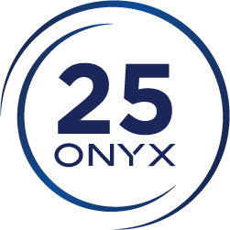

ONYX 25.5 Launch Overview
Advanced Workflow. Enhanced Accuracy. Greater Efficiency.
Address
Website
6915 South High Tech Drive, Midvale, Utah, 84047
www.onyxgfx.com

Slide 2


ONYX 25.5: The Next Step for ONYX 25 Users
Stable Workflows. Refined Usability. Bigger Possibilities.
ONYX Thrive 25.5 introduces smarter tools, deeper color capabilities, expanded profiling options, and improved workflow performance designed to help print providers work faster, produce more accurate output, and take on more advanced applications.
  Layout Tool enhancements
  Spectral color management
  Expanded profiling capabilities
  Adobe PDF Print Engine 7.1
  Cutting & finishing improvements
  Enhanced device support
  Platform stability and performance upgrades

Slide 3
Layout Tool Enhancements
Smart Spot Search. Spectral Color Matching.

Slide 4
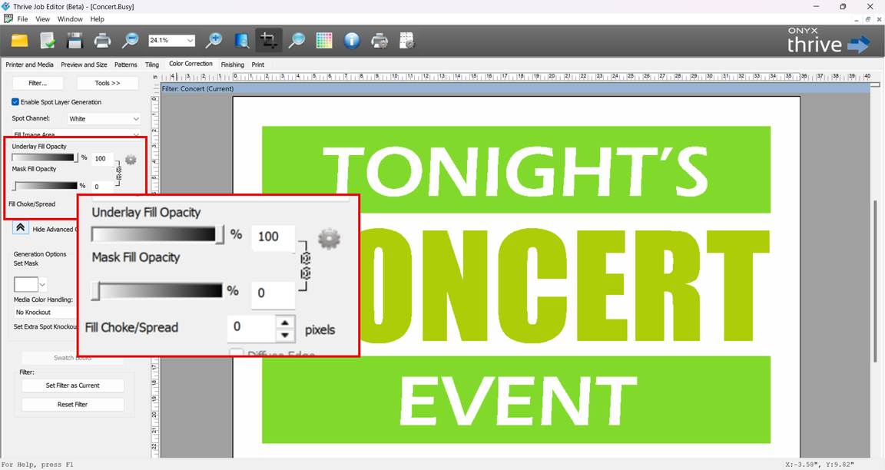
Design Smarter with Layout Tool Enhancements
White Ink & Specialty Ink Generation Now Available in Layout Tool
ONYX 25.5 brings white ink, spot color, and varnish layer creation directly into the Layout Tool. Instead of moving jobs between applications, operators can now generate and manage specialty ink effects where production decisions are already being made.
What it does
  Create white ink, spot color, and varnish layers directly in Layout
  Define underlays, masks, and fill areas
  Adjust choke and spread settings
  Configure opacity and threshold controls
  Preserve settings through templates and nests
Impact: Faster job preparation and fewer workflow interruptions when producing specialty print applications.

Slide 5
Color Confidence
Smart Spot Search. Spectral Color Matching.

Slide 6

Advanced Spot Layer Controls
Greater Flexibility for Specialty Applications
ONYX 25.5 expands specialty ink production with more control over how white, clear, spot, and varnish layers are applied. These enhancements make it easier to build complex applications while maintaining consistency throughout production.
New Capabilities
  Advanced masking and knockout options
  Clear coat and varnish overlay controls
  Support for multilayer workflows
  Custom threshold curves
  Media color simulation for substrate previews
Impact: Helps operators accurately visualize and prepare specialty jobs before they reach the printer, reducing costly trial-and-error.
Great for:
  Decals
  Labels
  Window graphics
  Packaging
  Industrial printing

Slide 7
Smarter Color Matching
ONYX Thrive 25.5 advances spot color accuracy through expanded spectral color technologies.
What Smart Spot Search Does
Brand colors are often difficult to reproduce consistently across different printers, media types, and ink configurations. ONYX 25.5 introduces new spectral color technologies designed to improve spot color accuracy and repeatability.
Key Innovations
  Smart Spot Search evaluates multiple ink combinations
  Spectral Color Matching improves spot color reproduction
  Hybrid ICC/iccMAX profile support
  Better matching of difficult brand colors
Impact: Greater confidence when producing color-critical work and fewer color-related reprints.

Slide 8
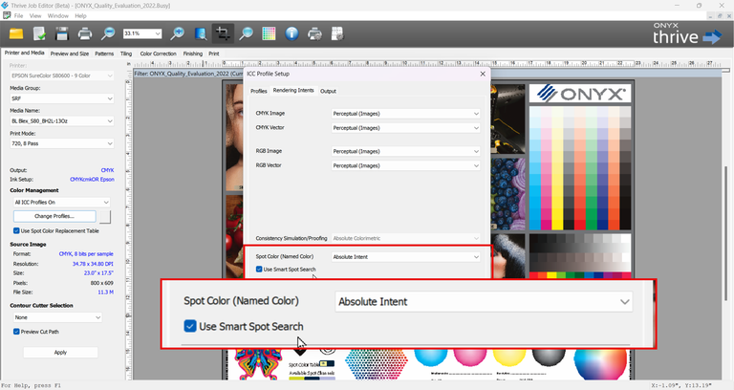
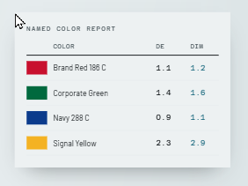
More Control Over Spot Colors
Every job has different color priorities. ONYX 25.5 introduces new controls that allow operators to optimize spot color reproduction on a job-by-job basis rather than relying on one global setting.
New Features
  Per-job spot rendering intent
  Quick Set spot rendering controls
  Job Editor spot rendering controls
  SwatchBooks rendering intent selection
Why It Matters
Different jobs often require different color priorities.
Operators can optimize output for:
  Color accuracy
  Visual appearance
  Production requirements
Rather than relying on a single global setting.

Slide 9
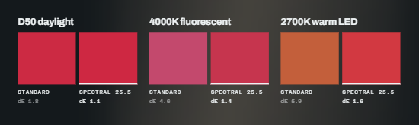
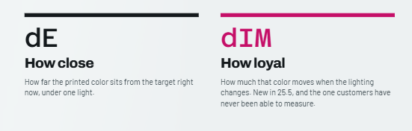
Color Evaluation & Verification
Matching color is only part of the process. ONYX 25.5 introduces new spectral measurement tools that help users evaluate and verify how colors will perform under real-world viewing conditions.
Reflectance Measurement
  Measure custom colors using spectral reflectance
  View measured spectral data
  Store reflectance-based color definitions
Metamerism Reporting
  Evaluate color matches under different lighting conditions
  View a metamerism index
  Better predict real-world color performance
Customer Benefits
  Improved color confidence
  Better customer communication
  Fewer color-related reprints

Slide 10
Workflow Control
Spot Layer Generation. Media Color Preview. Finishing Controls

Slide 11
Expanded Profiling Capabilities
As print providers continue adopting expanded-gamut technologies, profiling tools must evolve to support new ink configurations and wider color ranges. ONYX 25.5 expands its profiling capabilities to help users achieve more accurate color reproduction.
What it can do
  8-channel ICC profiling
  CMYK + Orange + Red + Green + Blue configurations
  Hybrid ICC / iccMAX profile creation
  Expanded-gamut printer support
Impact: Enables a larger printable color gamut and helps reproduce difficult brand colors more accurately.
Results
  Larger printable color gamut
  Better brand color reproduction
  Expanded application opportunities
Markets That Benefit
  Textile printing
  Ceramics
  Specialty graphics
  Industrial printing

Slide 12
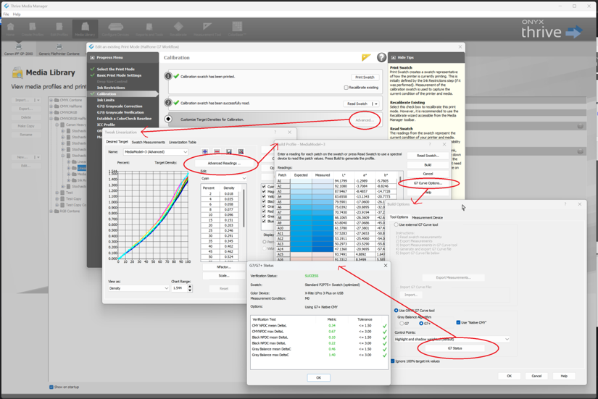
New G7 Status Viewer
The G7 Status Viewer provides greater visibility into profile optimization and calibration performance during media creation and maintenance.
Features that innovate
  Monitor G7 compliance progress
  View optimization iterations
  Track profile performance improvements
  Identify opportunities for refinement
Benefits
  Easier troubleshooting
  Greater process visibility
  Improved consistency across media
Impact: Simplifies troubleshooting and helps maintain more consistent color results across production environments.

Slide 13
Production Reliability
APPE 7.1. 8-Channel Profiling. Device Support. Stability Updates

Slide 14

Powered by Adobe PDF Print Engine 7.1
ONYX 25.5 is powered by the latest Adobe PDF Print Engine technology, providing greater compatibility with modern PDF workflows and improved rendering accuracy.
Benefits
  Improved PDF processing reliability
  Enhanced color fidelity
  Better transparency handling
  Extended-gamut transparency support
New for Extended Gamut Users
  PDF transparency can now render correctly in extended color spaces without requiring additional color simulation profiles.
Impact: More predictable output and fewer production delays caused by complex PDF files.

Slide 15
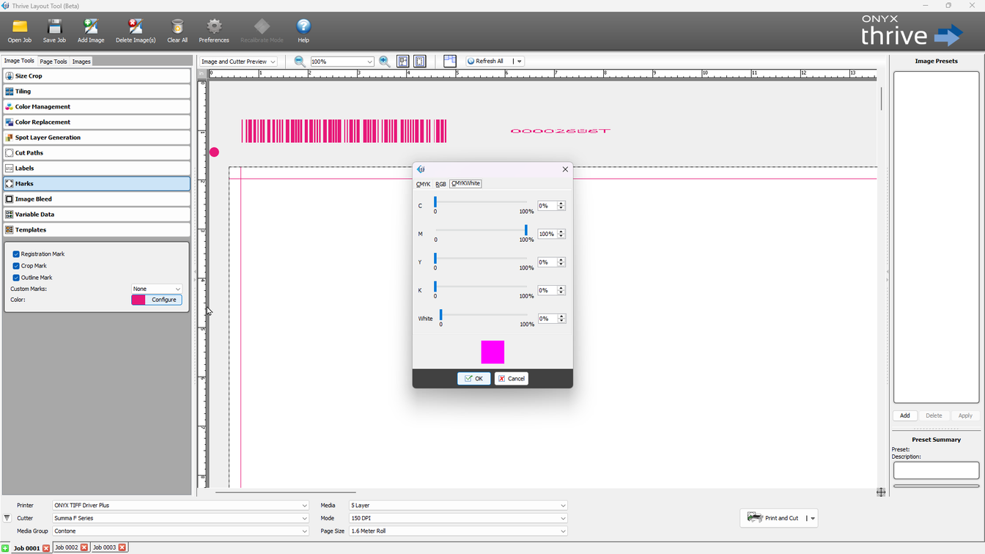
Enhanced Cutting & Finishing
Production quality extends beyond printing. ONYX 25.5 includes new finishing controls designed to improve cutter visibility, registration accuracy, and final output quality.
New Features
  Custom cutter mark colors
  Custom registration mark colors
  Edge mark color matching
  Cut offset controls
  Cut bleed width controls
Impact: Helps reduce finishing errors and improves accuracy for specialty applications.

Slide 16
Connectivity & Workflow Automation
Better Integration Across Production
ONYX Thrive 25.5 introduces a new IPP printing port. Modern production environments require seamless communication between software, printers, and automation systems. ONYX 25.5 introduces enhancements that improve connectivity and workflow integration.
Benefits
  Improved printer connectivity
  Support for modern printer environments
  Helps support evolving connectivity requirements
More printer settings available
Expanded media-level controls
Enhanced submission workflows
Improved integration opportunities
Data Access API Enhancements
Expanded communication between Dashboard and RIP-Queue.
Impact: Creates a stronger foundation for automation and future production workflows.

Slide 17
Performance & Stability Improvements
Many of the most important improvements in ONYX 25.5 happen behind the scenes. Extensive platform updates focus on reliability, stability, and long-term production performance.
Improvements Include
  Resource leak fixes
  Improved RIP-Queue reliability
  MongoDB startup improvements
  Qt 6 platform modernization
  General workflow performance enhancements
Customer Benefits
  Increased uptime
  Improved reliability
  More predictable operation
  Better experience in demanding production environments
Impact: Increased uptime and a more dependable RIP experience for high-volume production environments.

Slide 18
Expanded Device Support

Slide 19
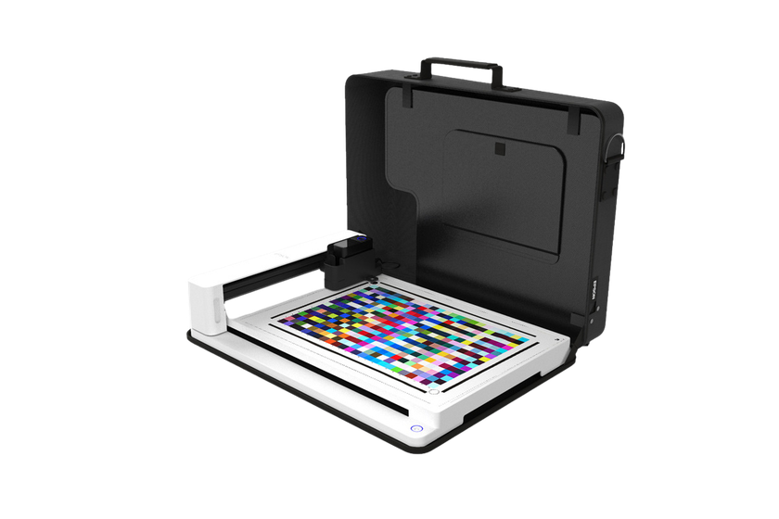
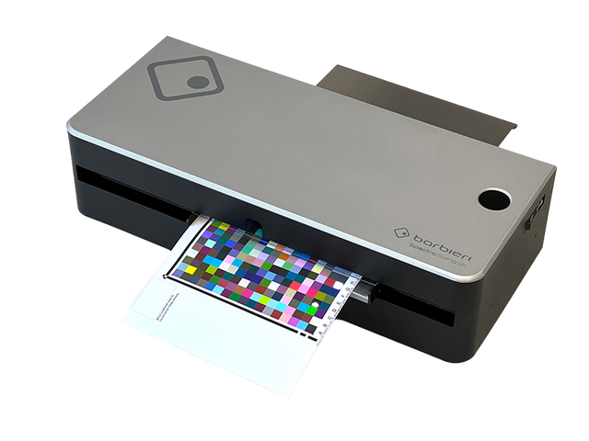
Device Support
ONYX 25.5 continues to expand support for industry-leading measurement and profiling devices, helping users integrate the tools they already rely on into their color workflows.
Epson SD-10 Auto Chart Reader
    May require network access to an Epson port
Spectro Swing qb
    Supported for precision color workflows
Barbieri LFP qb network connectivity, and additional device compatibility improvements are also available.

Slide 20
Why Upgrade to ONYX Thrive 25.5?

Slide 21
Why Upgrade?
ONYX 25.5 delivers meaningful advancements across color management, specialty printing, workflow efficiency, and production reliability. From improved spot color accuracy and spectral color technologies to integrated specialty ink generation and enhanced finishing controls, this release is designed to help print providers work smarter and produce more consistent results.
Key Benefits
  Generate white ink, spot color, and varnish layers directly in Layout
  Improve color accuracy with Smart Spot Search and Spectral Color Matching
  Expand profiling capabilities with Hybrid ICC/iccMAX and 8-channel support
  Increase workflow efficiency with Adobe PDF Print Engine 7.1 enhancements
  Improve finishing precision with new cutter and registration mark controls
  Benefit from expanded device compatibility, connectivity improvements, and increased system reliability
Impact: ONYX 25.5 helps print businesses reduce production complexity, improve output consistency, and confidently take on more demanding applications while maintaining a dependable day-to-day workflow.

Slide 22
Thank you!
Smarter Workflows. Refined Usability. Bigger Possibilities.

Slide 23
How to Get ONYX 25.5?
When is ONYX 25.5 globally available?
  Global availability is expected to be available on October 5, 2026
  Purchases on or after July 1ˢᵗ, 2026 is entitled to ONYX 25.5 at no charge but must request the update before December 31st, 2026
  New soft license orders after July 1st, 2026 already include ONYX 25.5
  ONYX 24 is our previous version, ONYX 22 is our legacy version
ONYX 25.5 is available through ONYX Advantage or a new license:
  Upgrade and purchase requests can be made by contacting an Authorized ONYX Reseller or by emailing sales@onyxgfx.com
  ONYX 25.5 is available for all ONYX software products, including ONYX Thrive and all ONYX RIP products
How do customers get the new release?
  ONYX 25.5 will be immediately available for download for existing ONYX Advantage agreement holders
  ONYX 25.5 will be immediately available to all ONYX Go subscribers
  Downloads will be available by visiting www.onyxgfx.com

